Slide 1


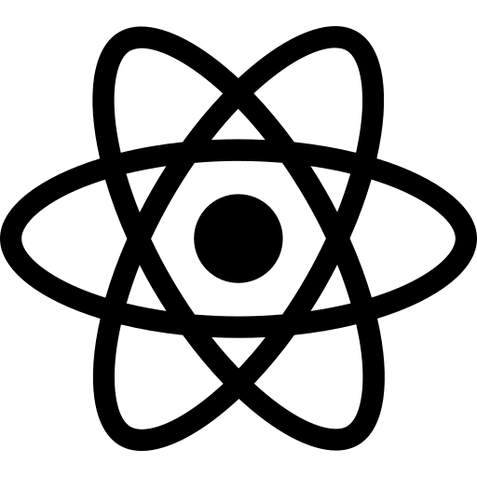
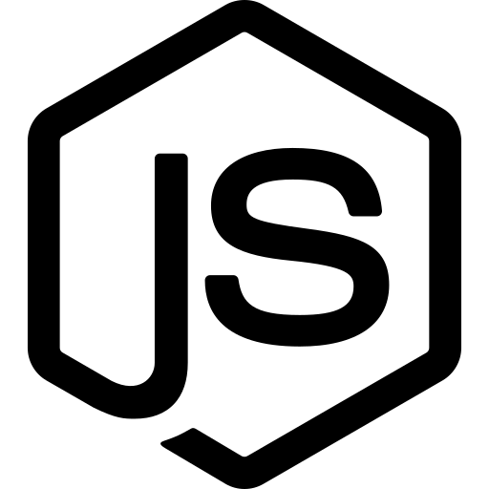
FULL-STACK WEB DEVELOPMENT COURSE
MERN Stack Development
Lecture 1
Introduction to Web Development & React Setup from Scratch
MongoDB
Express
React
Node.js

Slide 2


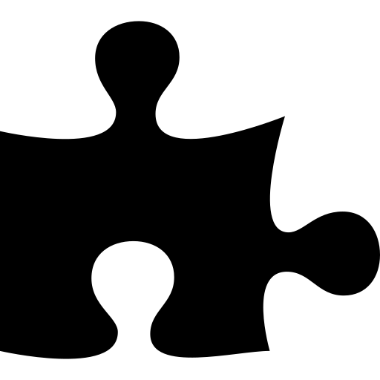
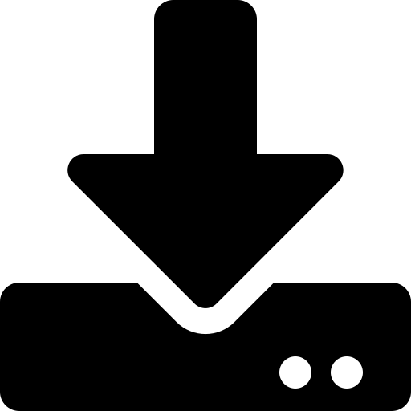

WELCOME
What We Will Learn Today
A gentle, step-by-step journey — no experience required.
1
2
3
How the Web Works
Frontend vs Backend
What is MERN?
Websites, browsers, and the internet explained simply
The two sides of every website
Meet the 4 technologies: MongoDB, Express, React, Node
4
5
6
Meet React
Install the Tools
Build Your First App
The tool we will use to build user interfaces
Set up Node.js and a code editor on your computer
Create and run a React project from scratch
MERN Stack Development | Lecture 1
2

Slide 3





THE BASICS
What Exactly Is a Website?
A website is simply a collection of pages that you can open using a web browser — like Chrome or Safari.
www.mywebsite.com
Think of it like a digital book with many pages, connected together
You can visit websites on a phone, tablet, or computer
Examples: Facebook, Amazon, Netflix — all are websites
MERN Stack Development | Lecture 1
3

Slide 4

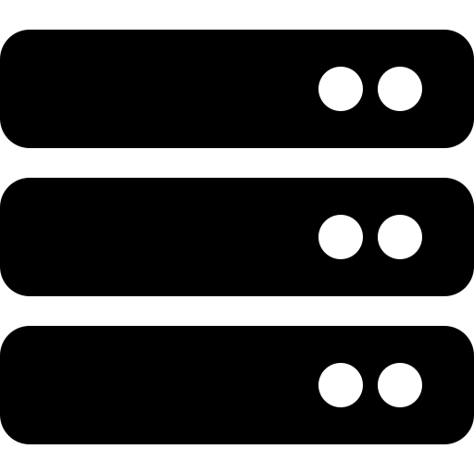
THE BASICS
How the Internet Works
Every time you open a website, two computers talk to each other.
Request
Client (You)
Server (Far Away Computer)
Your browser asks:
"Please show me this website"
The server replies:
"Here is the website you asked for"
Response (the website)
Simple takeaway: Browser asks a question, the server sends back an answer (the webpage). This happens in less than a second!
MERN Stack Development | Lecture 1
4

Slide 5
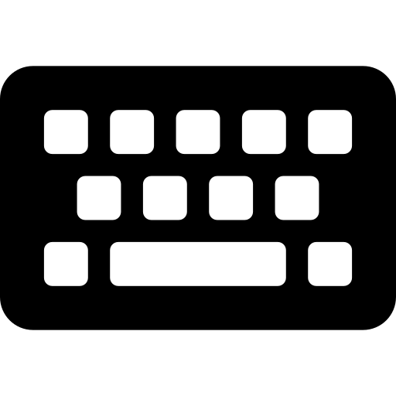

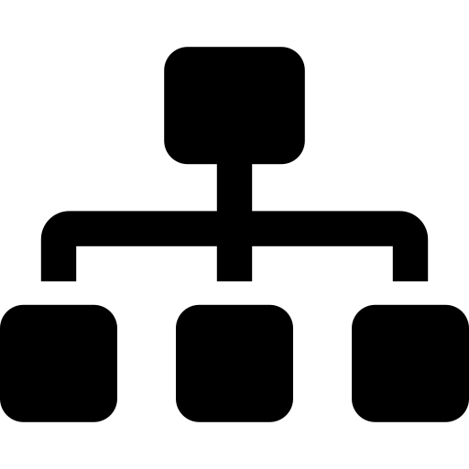
THE BASICS
What Happens When You Search a Website?
A closer look at the full journey — from typing a name to seeing the page.
1
2
3
4
5
You Type a Name
DNS Finds the Address
Browser Sends a Request
Server Prepares a Response
Browser Shows the Page
You enter "google.com" in the browser and press Enter
DNS works like a phone book — it turns the name into a numeric address (IP)
Your browser asks that address: "Please send me this website"
The server gathers the page's files (text, images, style)
The browser reads the files and displays the finished webpage
Good to know: All five steps usually finish in well under a second — that's why websites feel instant!
MERN Stack Development | Lecture 1
5

Slide 6

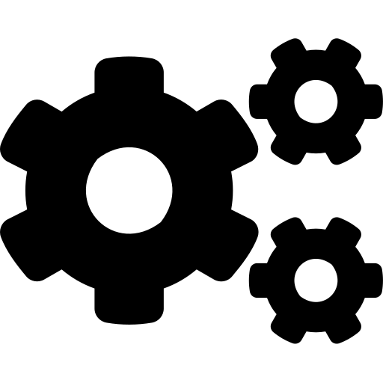

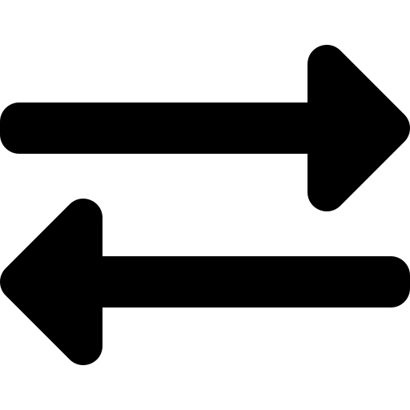
THE BASICS
Frontend vs Backend
Every website has two sides working together, like a restaurant.
Frontend
Backend
What the user SEES and CLICKS
What happens BEHIND the scenes
Buttons, colors, and images
Stores and manages data
Text, layout, and menus
Handles logins & security
Built using HTML, CSS & React
Built using Node, Express & MongoDB
"The dining area of a restaurant"
"The kitchen of a restaurant"
MERN Stack Development | Lecture 1
6

Slide 7

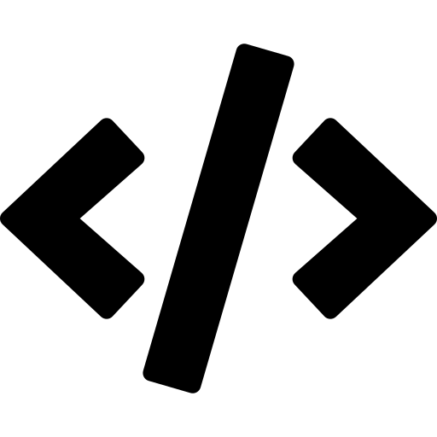


THE BASICS
What Is Programming, Really?
Programming means giving a computer clear, step-by-step instructions to follow — written in a special language it understands.
1
2
3
Write the Steps
Use a Code Language
Computer Follows Them
Like a recipe: "first do this, then do that"
We type instructions using JavaScript
The computer runs your instructions exactly
Don't worry — you don't need to know math or be a "genius" to learn programming. Everyone starts at zero!
MERN Stack Development | Lecture 1
7

Slide 8
MEET THE STACK
What Is the MERN Stack?
MERN is a set of 4 popular technologies used together to build full websites — from what users see to how data is stored.
M
E
R
N
MongoDB
Express
React
Node.js
Database
Backend Framework
Frontend Library
Runtime
Stores the website's data
Builds the server logic
Builds what users see
Runs JavaScript on the server
MERN Stack Development | Lecture 1
8

Slide 9
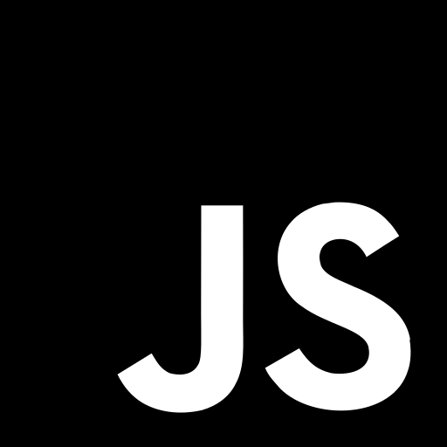

WHY IT MATTERS
Why Learn the MERN Stack?
One Language for Everything
Huge, Friendly Community
You use JavaScript for both frontend and backend — learn once, use everywhere.
Millions of developers use MERN, so help and tutorials are easy to find.
Used by Real Companies
Great for Beginners
Facebook, Netflix, and Uber use these exact technologies in production.
The tools are well documented and designed to be approachable for new learners.
MERN Stack Development | Lecture 1
9

Slide 10
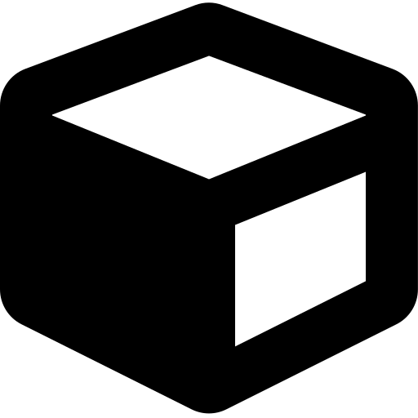
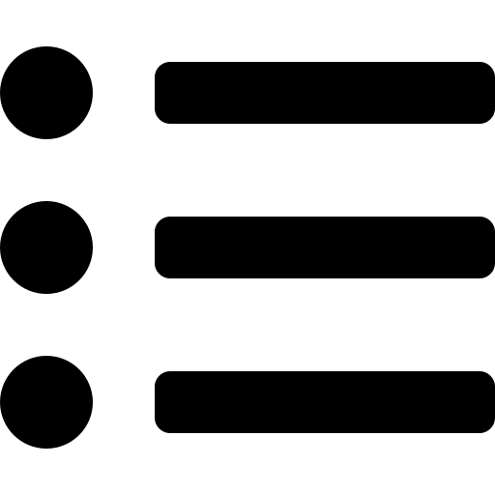
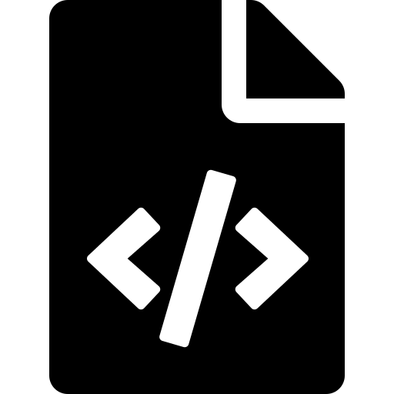
MEET REACT
What Is React?
React is a JavaScript library made by Facebook (Meta) for building the visual part of websites — buttons, forms, menus, and more.
Builds pages using small, reusable "building blocks" called components
A Page = Many Components
Updates only the part of the page that changes — fast and smooth
Header
Sidebar
Powers apps like Facebook, Instagram, and Netflix
Content
Footer
MERN Stack Development | Lecture 1
10

Slide 11
MEET REACT
Why Developers Love React
Reusable
Fast
#1
Easy
Components
Updates
Most Used
To Learn
Build once, use everywhere in your app
Only re-draws what actually changed on screen
The most popular frontend library worldwide
Simple ideas that build up step by step
MERN Stack Development | Lecture 1
11

Slide 12
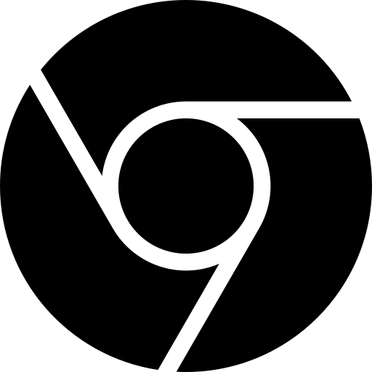
GETTING READY
Tools You Need Before We Start
Just three free tools — all easy to install on any computer.
Node.js
VS Code
Web Browser
Lets JavaScript run on your computer, outside the browser. Includes npm, a tool installer.
A free, popular code editor where we will write all our code.
Chrome, Firefox, or Edge — used to view and test our website.
Required
Required
You likely have this
MERN Stack Development | Lecture 1
12

Slide 13
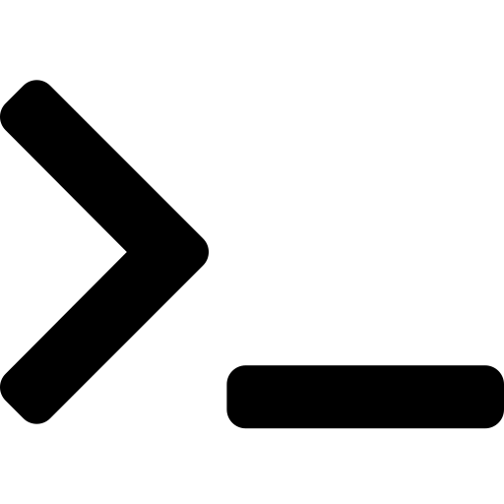
GETTING READY
Installing Node.js — Step by Step
Visit nodejs.org
Open your browser and go to the official Node.js website
1
Download the LTS Version
"LTS" means Long-Term Support — the most stable version
2
Run the Installer
Open the downloaded file and click "Next" through the setup
3
Verify Installation
Open a terminal and type: node -v to see the version number
4
MERN Stack Development | Lecture 1
13

Slide 14

HANDS-ON
Creating Your First React App
We will use a tool called Vite to create a new React project in seconds.
Terminal
What Just Happened?
$ npm create vite@latest my-app
A new project folder was created with everything you need
Creates a new project folder called my-app
$ cd my-app
npm downloaded all the tools your app depends on
Move into the project folder
$ npm install
Your app is now running at localhost:5173 in your browser
Downloads all required packages
$ npm run dev
Starts your app in the browser
MERN Stack Development | Lecture 1
14

Slide 15
HANDS-ON
Understanding Your Project Folder
Don't worry about every file — here are the ones that matter most for now.
my-app/
App.jsx
The main component — the heart of your website's content
node_modules/
src/
main.jsx
The starting point that loads your app into the browser
App.jsx
main.jsx
index.html
The single HTML page that your whole app lives inside
index.html
package.json
package.json
A list of your project's information and dependencies
MERN Stack Development | Lecture 1
15

Slide 16
RECAP
What You Learned Today
Websites work through a request & response between browser and server
Frontend is what users see; backend is what happens behind the scenes
MERN = MongoDB + Express + React + Node.js, working together
React builds user interfaces using small, reusable components
You now know how to install Node.js and set up your tools
You created and ran your very first React app with Vite
MERN Stack Development | Lecture 1
16

Slide 17

COMING UP NEXT
Lecture 2: React Components & JSX
Next time, we will write our first lines of React code and learn how components come to life.
Questions? Bring them to our next session
Practice: try installing Node.js before we meet again
Review today's slides — repetition builds confidence
Thank You!
MERN Stack Development | Lecture 1
17

